Slide 1
Finite Difference Method
by
Dr. Md. Rajibul Islam
CSE, UAP

Slide 2
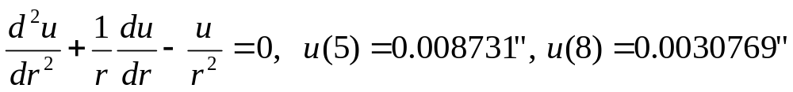
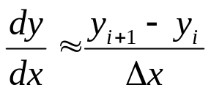
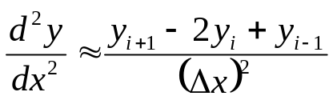
Finite Difference Method
An example of a boundary value ordinary differential equation is
The derivatives in such ordinary differential equation are substituted by finite divided differences approximations, such as

Slide 3
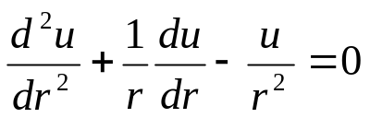
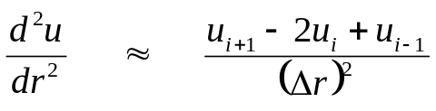
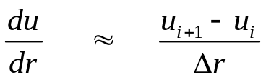
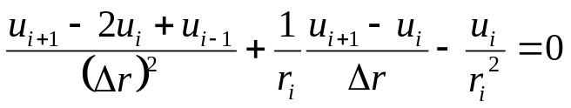
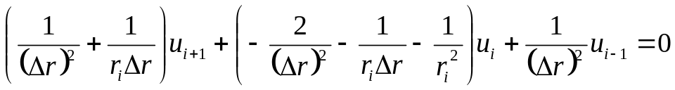
Example
Take the case of a pressure vessel that is being tested in the laboratory to check its ability to withstand pressure. For a thick pressure vessel of inner radius a and outer radius b, the differential equation for the radial displacement u of a point along the thickness is given by
The pressure vessel can be modeled as,
Substituting these approximations gives you,

Slide 4



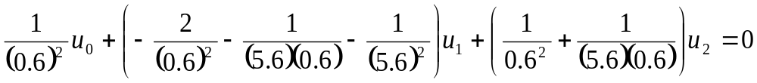



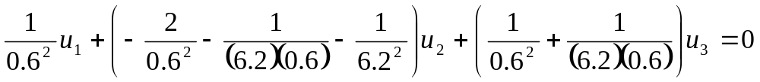

Solution
Step 1
At node
Step 2 At node
Step 3 At node

Slide 5


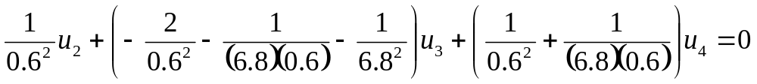


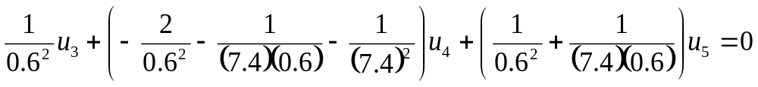



Solution Cont
Step 4 At node
Step 5 At node
Step 6 At node

Slide 6
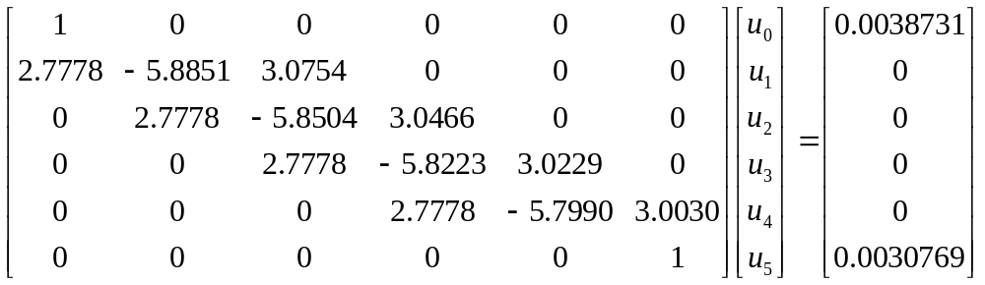






Solving system of equations

Slide 7
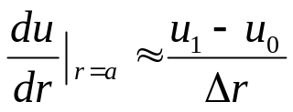
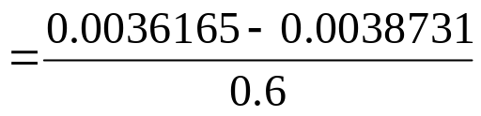

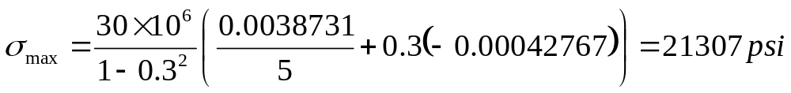
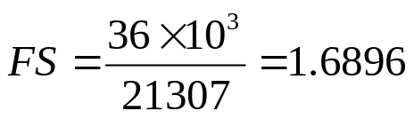


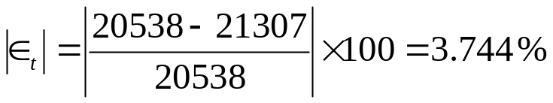
Solution Cont

Slide 8
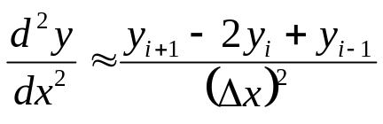
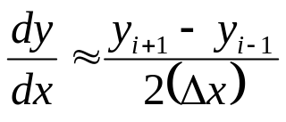
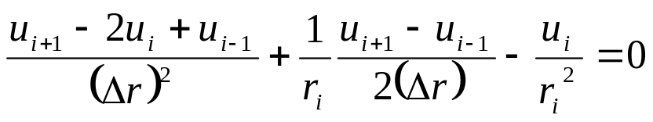
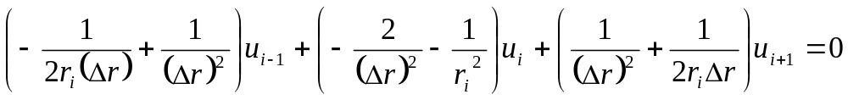
Solution Cont
Using the approximation of
and
Gives you

Slide 9



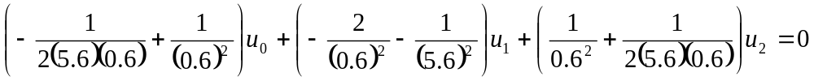


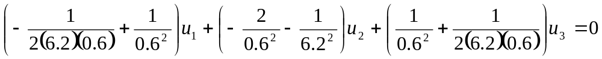

Solution Cont
Step 1 At node
Step 2 At node
Step 3 At node

Slide 10

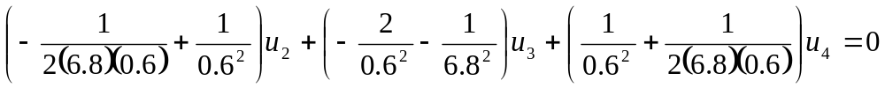


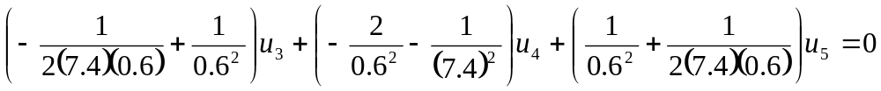



Solution Cont
Step 4 At node
Step 5 At node
Step 6 At node

Slide 11
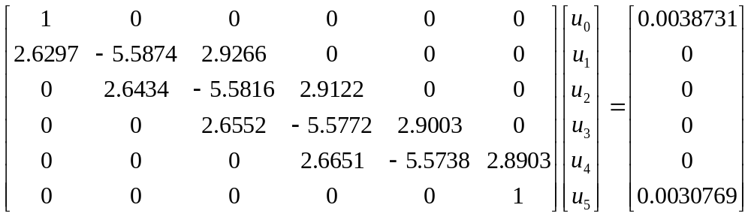




Solving system of equations

Slide 12
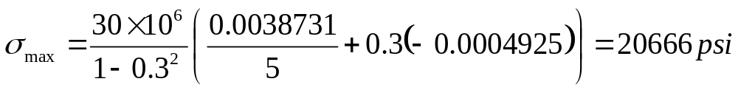
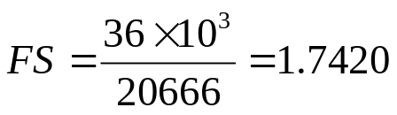

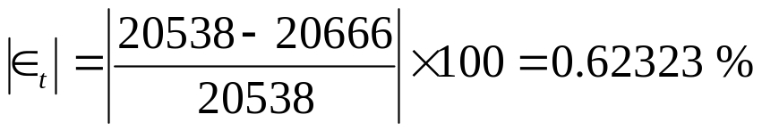
Solution Cont

Slide 13
Comparison of radial displacements
Table 1 Comparisons of radial displacements from two methods
r | u_{exact} | u_{1st order} | |є_{t}| | u_{2nd order} | |є_{t}|
5 | 0.0038731 | 0.0038731 | 0.0000 | 0.0038731 | 0.0000
5.6 | 0.0036110 | 0.0036165 | 1.5160×10⁻¹ | 0.0036115 | 1.4540×10⁻²
6.2 | 0.0034152 | 0.0034222 | 2.0260×10⁻¹ | 0.0034159 | 1.8765×10⁻²
6.8 | 0.0032683 | 0.0032743 | 1.8157×10⁻¹ | 0.0032689 | 1.6334×10⁻²
7.4 | 0.0031583 | 0.0031618 | 1.0903×10⁻¹ | 0.0031586 | 9.5665×10⁻³
8 | 0.0030769 | 0.0030769 | 0.0000 | 0.0030769 | 0.0000

Slide 14
THE END

